Slide 1
Web Security
CS 5352/6352 Computer Security
Lecture note
Dr. Sajedul Talukder

Slide 2
Lecture Outline
Attacks against browsers
Attacks against and from web sites
Attacks seeking sensitive data
Attacks through email

Slide 3
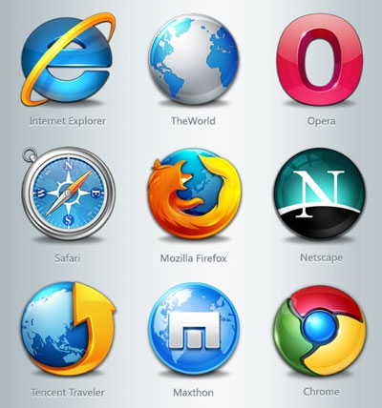
What is a Browser?
Browsers are the software most users perceive as the gateway to the Internet.
Connect to a particular web address, fetch and display content from that address, and transmit data from a user to that address.
Browser Complications:
  Browsers often connect to more than just the URL listed in the address bar
  Fetching a page automatically fetches lots of other data
  If the browser is corrupted, you have no protection
  Most browsers support plug-ins, which can be malicious or badly implemented
  Browsers can access data on the user computer
  The user does not know what data the browser is sending

Slide 4
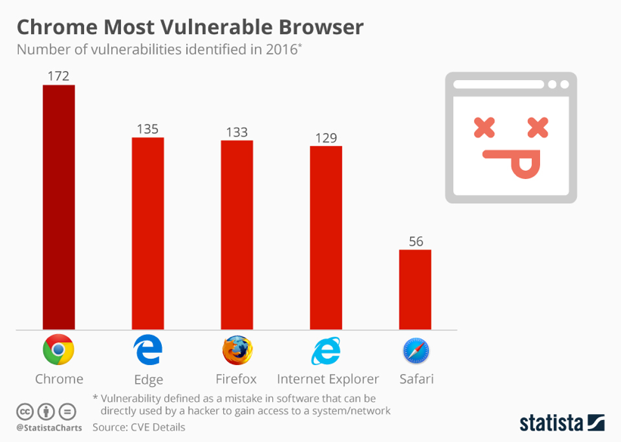
Browser Attacks
Browsers are standard, straightforward pieces of software that expose users to significantly greater security threats than most other kinds of software.
Being a popular target, they present many vulnerabilities for attack.
Popular attack types:
  Man-in-the-Browser
  Keystroke Logger
  Page-in-the-Middle
  Program Download Substitution
  User-in-the-Middle

Slide 5
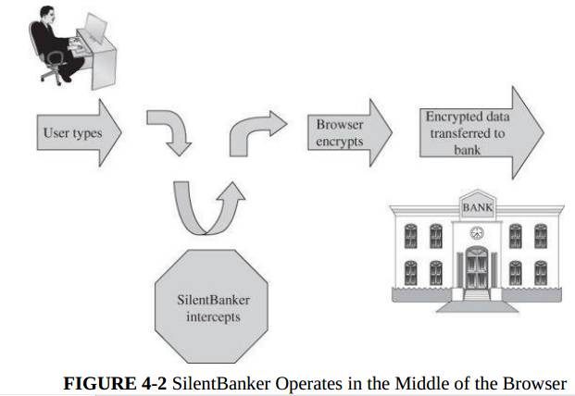
Man-in-the-Middle Attack
Malicious code inserted into the browser can read, copy, and redistribute anything the user enters in a browser.
SSL encryption is applied in the browser; data are vulnerable before being encrypted.
SilentBanker started with a list of over 400 URLs of popular banks throughout the world. Whenever it saw a user going to one of those sites, it redirected the user’s keystrokes through the Trojan horse and recorded customer details that it forwarded to remote computers .

Slide 6
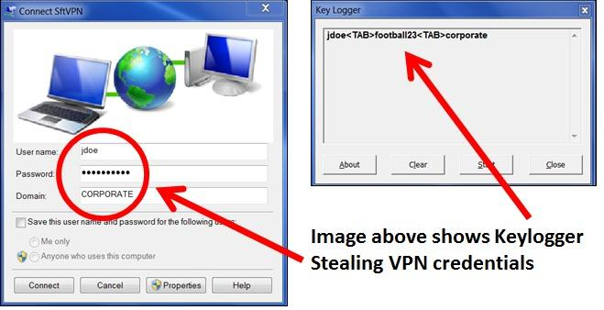
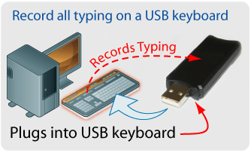
Keystroke Logger Attack
A keystroke logger (or key logger) is either hardware or software that records all keystrokes entered.
As a hardware device, a keystroke logger is a small object that plugs into a USB port, resembling a plug-in wireless adapter or flash memory stick.
In software, the logger is just a program installed like any malicious code.
Can capture passwords, login identities, and all other data typed on the keyboard.

Slide 7
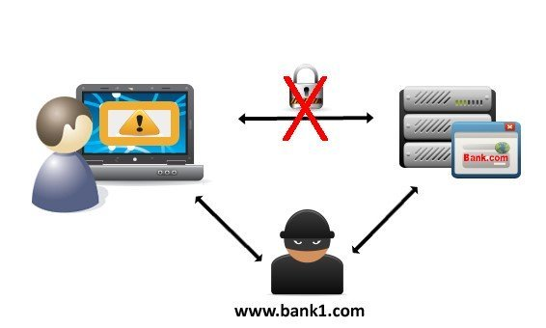
Page-in-the-Middle Attack
Another type of browser attack in which a user is redirected to another page.
A page attack might wait until a user has gone to a particular web site and present a fictitious page for the user.
Difference from man-in-the-browser attack is that instead of silently capturing data, the attacker redirects the user, presenting different web pages for the user to see.

Slide 8
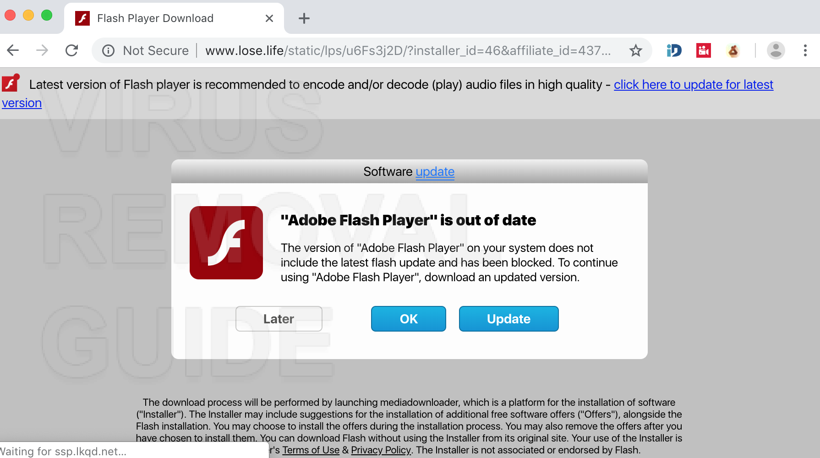
Program Download Substitution Attack
A page could trick you into downloading a file that appears to be an application you want.
In reality, it's a virus, Trojan horse, or other malware.
How do you know what you're downloading?
Often, there's no way to be sure.
This attack also defeats users’ access controls, because the user intentionally accepts this software.

Slide 9
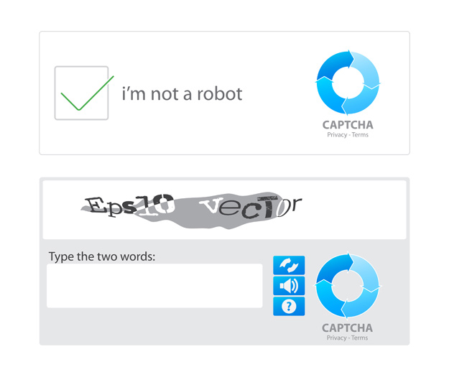
User-in-the-Middle Attack
A user-in-the-middle attack tricks an unsuspecting user to do something only a human can do, like solve a CAPTCHA.
Spam and porn companies often have the same owners and perform this attacks.
People get offers for free access to porn, provided that they fill out a CAPTCHA.
At the moment a user requests access, the spam originator automatically generates a request to create a new email account (Hotmail, for example). Hotmail presents a CAPTCHA, which the spammer then presents to the pornography requester.

Slide 10
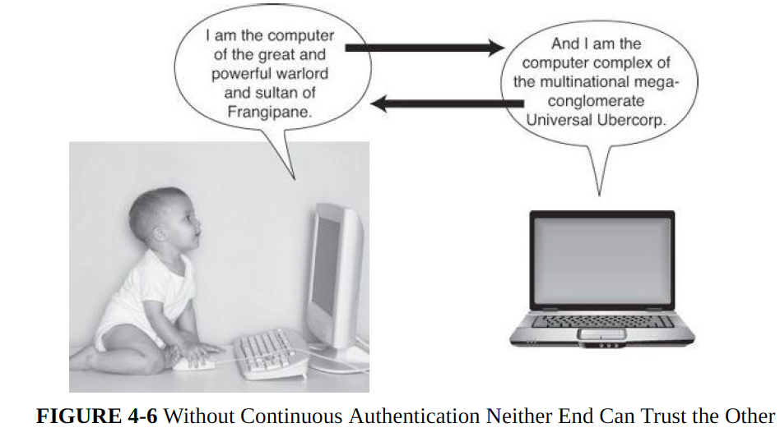
Identification and Authentication Problems
If A cannot be assured that the sender of a message is really B, A cannot trust the authenticity of anything in the message.
Few people will, let alone can, memorize many unique, long, unguessable passwords.
If authentication involves computing a cryptographic result, the encryption key has to be placed somewhere during the computing, and it might be susceptible to copying by another malicious process.
Malicious software can undermine authentication by eavesdropping on (intercepting) the authentication data and allowing it to be reused later.
The system needs assurance that the user is authentic, but the user needs that same assurance about the system.

Slide 11
Failed Identification and Authentication: Countermeasures
Web authentication can be done with approaches beyond or in addition to a password:
Shared secret (the time or date of last login, time of last update, or size of a particular application file)
Secret questions asked earlier
One-time password
Password provided by a SecurID
Out-of-band communication (bank card & PINs mailed Separately)
Two-factor authentication (text, call, U2F)
Continuous Authentication
Notes:
The RSA SecurID authentication mechanism consists of a "token" — either hardware (e.g. a USB dongle) or software (a soft token) — which is assigned to a computer user and which generates an authentication code at fixed intervals (usually 60 seconds) using a built-in clock and the card's factory-encoded random key.
Universal 2nd Factor is an open authentication standard that strengthens and simplifies two-factor authentication using specialized Universal Serial Bus or near-field communication devices based on similar security technology found in smart cards.

Slide 12
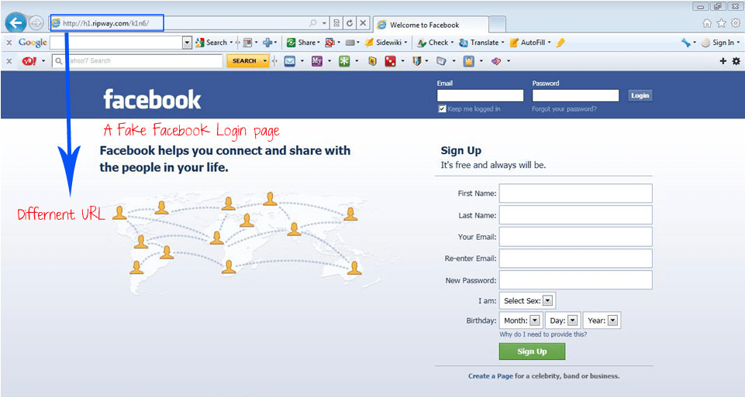
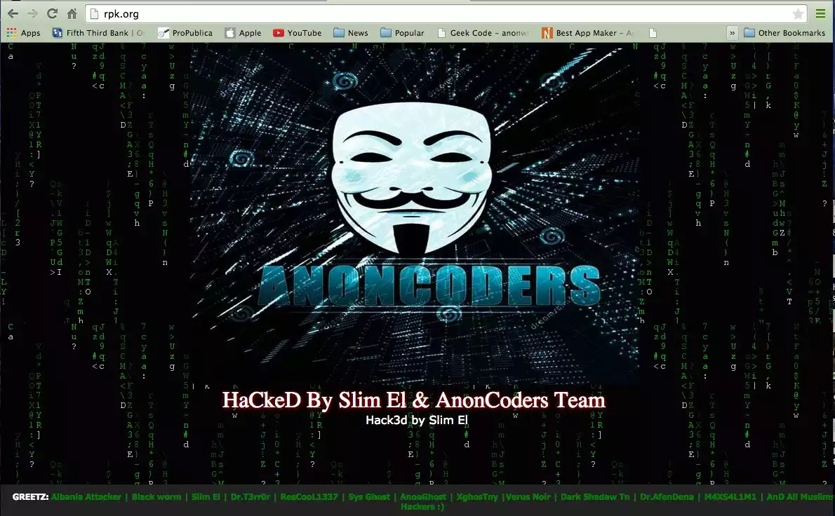
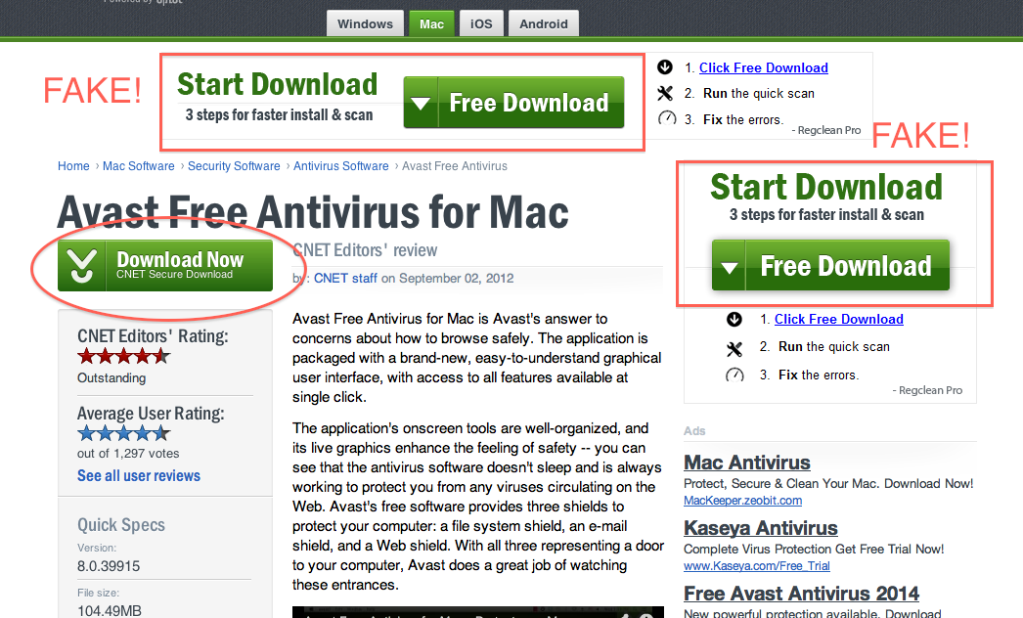
Web Attacks Targeting Users
Users are the weakest link in the entire web architecture. Attacks include:
  False or Misleading Content
  Defaced Web Site
  Fake Web Site
  Fake Code
  Malicious Web Content

Slide 13
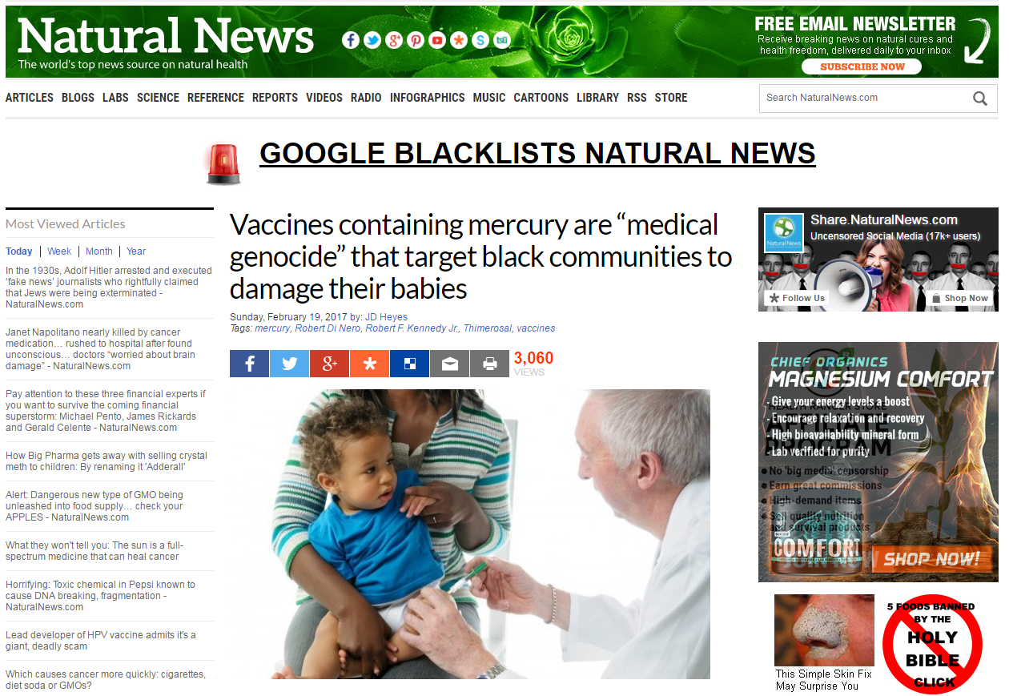
False or Misleading Content
False/misleading content are often published as fake news—hoaxes, propaganda, and disinformation purporting to be real news—often using social media to drive web traffic and amplify their effect.
An incoherent message, a web page riddled with grammatical errors, or a peculiar political position can all alert you that something is suspicious.
But a well-crafted forgery may pass without question.

Slide 14
Defaced Web Site
Website defacement is when an attacker changes the content of a legitimate website.
Usually, this is done by exploiting a weakness in authentication of the people who are allowed to update content.
These attacks can be pranks or to demonstrate that security is poor.
Often to embarrass government websites.
They can be done to show political disagreement with the website or the agency behind the website.
The changes could be subtle enough that the change is not noticed for a while.

Slide 15
Fake Web Site
Websites are very easy to clone.
By their nature, the HTML, JavaScript, CSS, and images used to create a website are all publicly available.
It's even possible to link to current images on the real website.
This attack is usually designed to trick users into entering private information into the malicious website.
All the attacker has to do is change the values of links to redirect the unsuspecting victim to points of the attacker’s choosing.
www.fakebook.com

Slide 16
Protecting Web Sites Against Change
Integrity Checksums
  a checksum, hash code, or error detection code is a mathematical function that reduces a block of data (including an executable program) to a small number of bits
  integrity checksums can detect altered content on a web site
  this approach only works if the data doesn't constantly change
Signed Code or Data
  a digital signature is an electronic seal that can vouch for the authenticity of a file or other data object
  the recipient can inspect the seal to verify that it came from the person or organization believed to have signed the object and that the object was not modified after it was signed
  however, the threat of signed malicious code is real. In 2012, Adobe announced that part of its code-signing infrastructure had been compromised and that the attackers had been able to distribute illegitimate code signed with a valid Adobe digital signature.

Slide 17
Malicious Web Content
Webpages with unmistakably harmful intent
  Fake Code
  Substitute Content
  Web Bug
  Clickjacking
  Drive-By Download

Slide 18
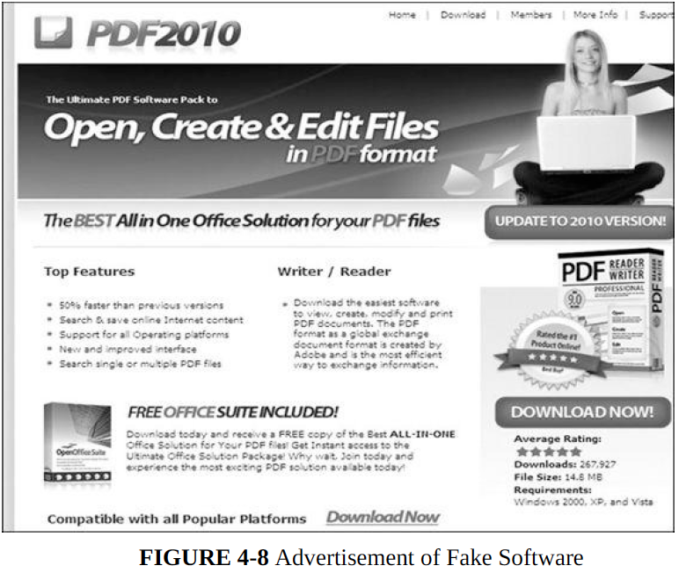
Fake Code
Programs intentionally installed that may advertise one purpose but do something entirely different.
Easiest way for a malicious code writer to install code on a target machine is to create an application that a user willingly downloads and installs.
Malicious software can masquerade as legitimate.
May go on unnoticed for some time if the malware at least seems to implement its ostensible function.

Slide 19
Substitute Content
Replacing parts of a web site with malicious intent in a way that does not attract attention.
Sites offering content as PDF files may have a link through which to download the free PDF file display tool, Adobe Reader.
Attacker may modify the link on the site with the PDF file so that it points to the attacker’s site instead of Adobe’s.
For the attacker, it is only tiny change to the original site’s HTML code.

Slide 20
Web Bug
web page is made up of many types of data: some text, graphics, executable code, and scripts which are fetched and processed from various web locations.
When a remote file is fetched for inclusion, the request also sends the IP address of the requester, the type of browser, and the content of any cookies stored for the requested site.
Some advertisers may plant a web bug, also called a clear GIF, 1x1 GIF, or tracking bug, a tiny image, as small as 1 pixel by 1 pixel as part of their subscription service to website owners.

Slide 21
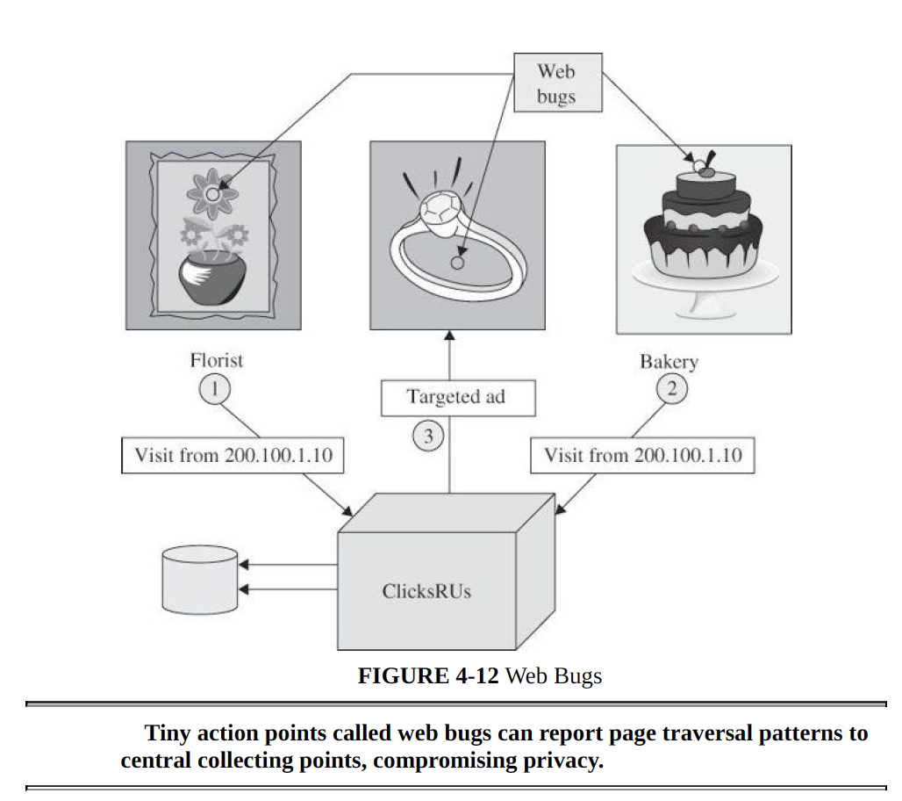
Web Bug
Web Bug may be used to perform the following privacy attacks
  Web history tracking
  Correlation marketing
  User shopping preference manipulation
  Offer targeted ad
Notes:
Your florist might subscribe to a web tracking service, which we name ClicksRUs. The
florist includes a web bug in its web image, so when you load that page, your details are
sent to ClicksRUs, which then installs a cookie.
If you leave the florist’s web site and next go to a bakery’s site that also subscribes to tracking with ClicksRUs, ClicksRUs records the coincidence of these two firms. After correlating these data points, ClicksRUs can inform the florist and the bakery that they have common customers and might develop a joint marketing approach.
ClicksRUs can determine that you went from florist A to florist B to florist C and back to florist A, so it can report to them that B and C lost out to A, helping them all develop more successful marketing strategies.
ClicksRUs can infer that you are looking for a gift and will offer a targeted ad on the next site you visit.

Slide 22
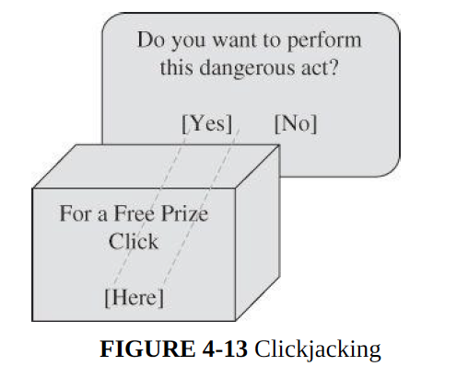
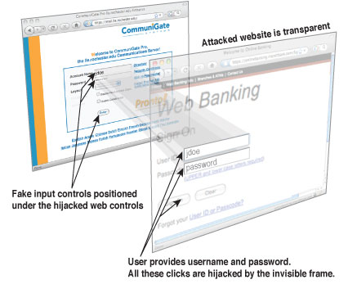
Clickjacking
Clickjacking is when you think you're clicking on one button, but you're really clicking on another.
Superimpose a benign image underneath the malicious image (remember, the malicious image is transparent) with what looks like a button directly under the real (but invisible) button for the action the attacker wants (such as, “Yes” install the program).
Induce the victim to click what seems to be a button on the benign image.
These attacks are possible because web pages can have transparent frames

Slide 23
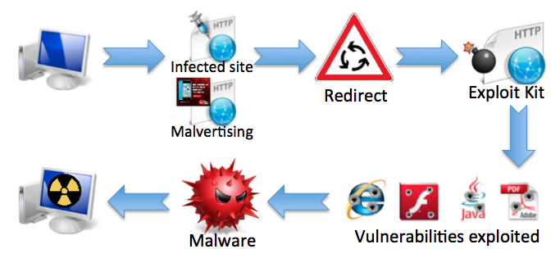
Drive-By Download
Drive-by download is an attack in which code is downloaded, installed, and executed on a computer without the user’s permission and usually without the user’s knowledge.
Website may be compromised with malicious-exploit script where clicking a button or link may install malicious code carefully matched to the user’s browser and operating system type.
In the worst case, a web page may probe the computer for vulnerabilities that will permit later downloads without permission.

Slide 24
Protecting Against Malicious Web Pages
Access control
  basic protection against malicious web content
  prevent the malicious content from becoming established or executed
  requires stronger action by both the user and the operating system
  operating systems must require administrative privilege to install programs
Responsible web page owner
  ensure that code on a web page is good, clean, or suitable
  develop web pages from trusted sources: libraries, reused modules, third parties, contractors, and original programming
  monitor over time to be sure the code stays good

Slide 25
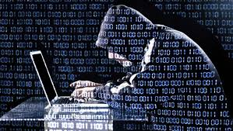
Obtaining User or Website Data
Attack involves tricking a database management system into revealing otherwise controlled information.
Several examples of attacks in which website data can be leaked to extract sensitive information:
  Cross-Site Scripting
  SQL Injection
  Dot-Dot-Slash
  Server-Side Include

Slide 26
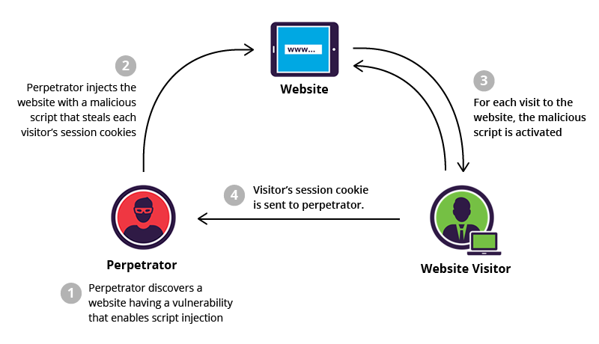
Cross-Site Scripting
Cross-site Scripting (XSS) refers to client-side code injection attack wherein an attacker can execute malicious scripts (also commonly referred to as a malicious payload) into a legitimate website or web application.
XSS is amongst the most rampant of web application vulnerabilities and occurs when a web application makes use of unvalidated or unencoded user input within the output it generates.
Cross-site scripting allows an attacker to execute malicious scripts in another user's browser.

Slide 27
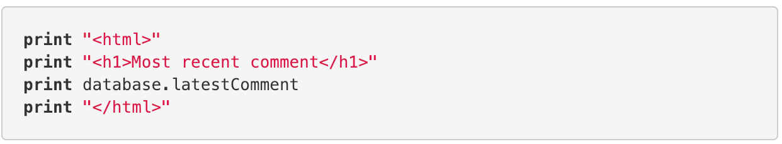
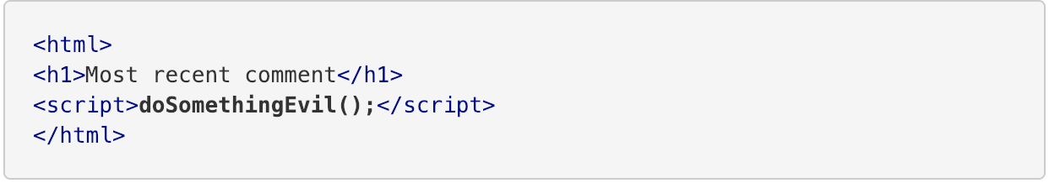
Cross-Site Scripting
The following server-side pseudo-code is used to display the most recent comment on a web page.
The above page is vulnerable to XSS because an attacker could submit a comment that contains a malicious payload such as <script>doSomethingEvil();</script>.
When the page loads in the victim’s browser, the attacker’s malicious script will execute, most often without the user realizing or being able to prevent such an attack.

Slide 28
What is a SQL Injection Attack?
Many web applications take user input from a form
Often this user input is used literally in the construction of a SQL query submitted to a database. For example:
  SELECT productdata FROM table WHERE productname = ‘user input product name’;
A SQL injection attack involves placing SQL statements in the user input

Slide 29
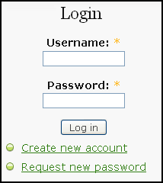
SQL Injection
Legitimate Query:
SELECT * from users
WHERE username = ‘admin’ and
password = ‘123’
Injected SQL code:
SELECT * from users where username = ‘admin’
and password = ‘XXX’ or ‘1’=‘1’

Slide 30
A More Malicious Example
What if the attacker had instead entered:
  blah‘; DROP TABLE prodinfo; --
Results in the following SQL:
  SELECT prodinfo FROM prodtable WHERE prodname = ‘blah’; DROP TABLE prodinfo; --’
  Note how comment (--) consumes the final quote
Causes the entire database to be deleted
  Depends on knowledge of table name
  This is sometimes exposed to the user in debug code called during a database error
  Use non-obvious table names, and never expose them to user
Usually data destruction is not your worst fear, as there is low economic motivation

Slide 31
Dot-Dot-Slash
In Unix and Windows, parent directory traversal is executed using ../ (dot dot slash).
Attack consists in exploiting insufficient security validation / sanitization of user-supplied input file names, such that characters representing "traverse to parent directory" are passed through to the file APIs.
This attack exploits a lack of security (the software is acting exactly as it is supposed to) as opposed to exploiting a bug in the code.
Notes:
]

Slide 32
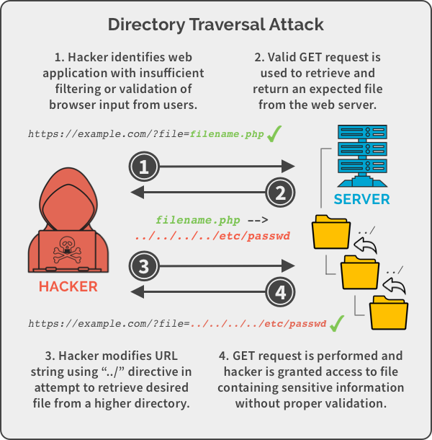
Dot-Dot-Slash
Notes:
]

Slide 33
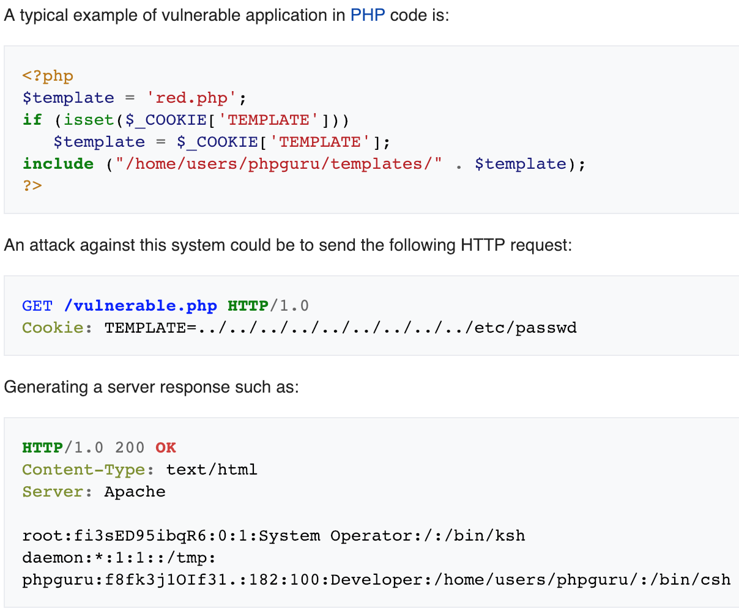
Dot-Dot-Slash
Notes:
The repeated ../ characters after /home/users/phpguru/templates/ has caused include() to traverse to the root directory, and then include the Unix password file /etc/passwd.

Slide 34
Server-Side Includes Injection
SSIs are directives present on Web applications used to feed an HTML page with dynamic contents.
The Server-Side Includes attack exploits a web application by injecting scripts.
One of the server-side includes commands is exec, to execute an arbitrary file on the server.
The following SSI command opens a Telnet session from the server:
An attacker may find it interesting to execute commands such as chmod (change access rights to an object), sh (establish a command shell), or cat (copy to a file).

Slide 35
Server-Side Includes Injection
Executes code to show firstname and lastname in output:
Attack:

Slide 36
Email Security
Email is one of the most common and most successful attacks on the internet. Recent statistics cite up to 90% of successful attacks against businesses begin with a malicious email.
Emails can contain malicious files like virus and malware, link to malicious web sites, or try to coerce or convince you to give away personal information, like your username and password.
Cybercriminals using email to attack businesses are becoming more and more effective at evading detection – technology alone is only marginally effective at blocking these new email threats.

Slide 37
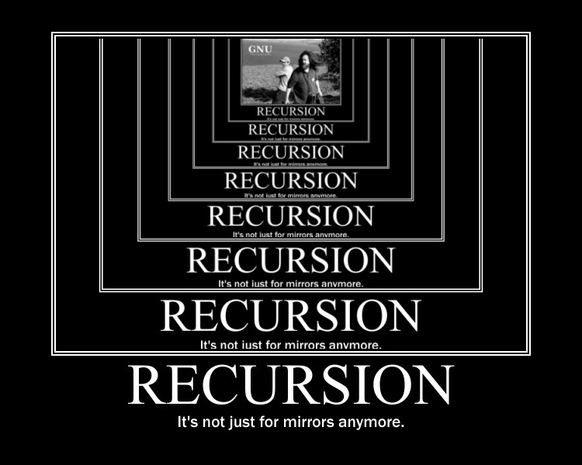
Email Attacks
Fake Email/ Spoofing
Spam
Fake (Inaccurate) Email Header Data
Viruses and Malware
Social Engineering

Slide 38
Email Spoofing
Also called Business Email Compromise, email spoofing typically uses an email address that mimics a trusted party, such as a manager, executive or co-worker, and can be difficult to recognize (especially on mobile devices).
Typically these scams involve a wire transfer or request for sensitive files, such as W-2s or legal documents.
There is usually some urgency involved to prevent the recipient from following up on the request directly or following procedures.

Slide 39
Email Spoofing Example
Notes:
https://info.phishlabs.com/blog/fbi-fraud-alert-business-e-mail-compromise

Slide 40
Phishing
Phishing is the attempt to obtain sensitive information such as usernames, passwords, and credit card details (and, indirectly, money), often for malicious reasons, by disguising as a trustworthy entity in an electronic communication. (Wikipedia - https://en.wikipedia.org/wiki/Phishing )
Common phishing scams attempt to use coercion or scare tactics to get you to enter your username and password into a phony web site, such as:
  A “required action” as a part of a system or quota upgrade
  A “required action” to prevent email account closure
  A “trusted” vendor, such as a fake Dropbox or Google alert
  A “legitimate” banking alert
Once they have your password, phishers use your account credentials to send more phishing messages, change financial account information or redirect checks/deposits.

Slide 41
Types of Phishing Attacks
Spear phishing - Phishing attempts directed at specific individuals or companies have been termed spear phishing. Attackers may gather personal information (social engineering) about their targets to increase their probability of success. This technique is, by far, the most successful on the internet today, accounting for 91% of attacks.
Clone phishing - A type of phishing attack whereby a legitimate, and previously delivered email containing an attachment or link has had its content and recipient address(es) taken and used to create an almost identical or cloned email. The attachment or link within the email is replaced with a malicious version and then sent from an email address spoofed to appear to come from the original sender.
Voice Phishing - Voice phishing is the criminal practice of using social engineering over the telephone system to gain access to personal and financial information from the public for the purpose of financial reward. Sometimes referred to as 'vishing’, Voice phishing is typically used to steal credit card numbers or other information used in identity theft schemes from individuals.

Slide 42
Types of Phishing Attacks
Social Engineering - On your Facebook profile or LinkedIn profile, you can find: Name, Date of Birth, Location, Workplace, Interests, Hobbies, Skills, your Relationship Status, Telephone Number, Email Address and Favorite Food. This is everything a Cybercriminal needs in order to fool you into thinking that the message or email is legitimate.
Link Manipulation - Most methods of phishing use some form of deception designed to make a link in an email appear to belong to the spoofed organization or person. Misspelled URLs or the use of subdomains are common tricks used by phishers. Many email clients or web browsers will show previews of where a link will take the user in the bottom left of the screen or while hovering the mouse cursor over a link.

Slide 43
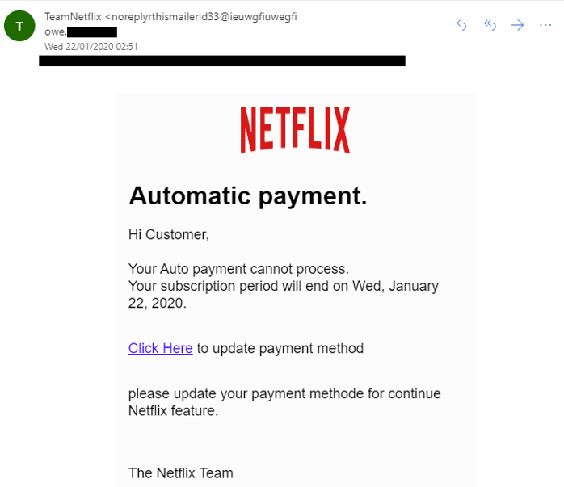
Spear Phishing
Special class of phishing
  Constructed in a very specific way
  Directly target to specific individual

Slide 44
Examples of Phishing Attacks
Spear Phishing
The first question you have to ask is, “Do I know this person?” or “Am I expecting an email from the person?” If you answered no to either question, you must take a harder look at other aspects of the email
A large amount of phishing emails will blank out the To: or Cc: fields so that you cannot see that this is a mass email to a large group of people.
Phishing emails will often come with subjects that are in all capitals or have multiple exclamation marks in order for you to think that this email is important or that you should take the recommended action within the email.
Hovering your mouse over the link, you can see that this is not taking you to a valdosta.edu address, but rather to an external site. This site would either prompt you for a password, then steal that password, or would download a malicious file infecting your computer.

Slide 45
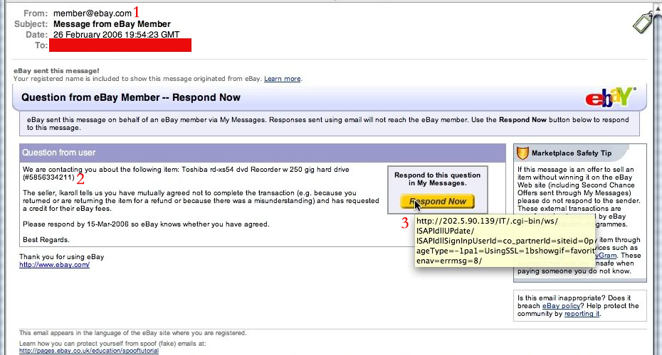
Examples of Phishing Attacks
Clone Phishing
These emails are harder to spot because they look exactly like legitimate emails you would normally receive. The first cue that something is not right with this email is the sender. It is a generic address, member@ebay.com. You would never see this from a legitimate email, you would see the username of the buyer/seller; e.g.; valdostarocks@ebay.com
The question you have to ask yourself is did I buy anything from ebay recently, and if I did, is this what I purchased? If no to these questions, then you more than likely have a phishing email.
The last piece is the most critical in seeing if the email is in fact a phishing email. If you hover your mouse over the button it is wanting you to press, you see that this is not taking you to an ebay.com site, but rather an external site that will more than likely try to steal your ebay credentials.
The signature often will end in a generic sign off as to not arouse suspicion as to the sender.

Slide 46
Examples of Phishing Attacks
Clone Phishing

Slide 47
Examples of Phishing Attacks
Link manipulation
This is actually from a linkedin.com address, so first you have to ask whether or not this is from someone you know or someone that would be emailing you about your account.
One again, cybercriminals will use a subject line trying to get your attention, often using all caps, catchy word or multiple exclamation marks.
Hovering your mouse over the link, you can see that this is not a legitimate linkedin.com link, but an external one designed to steal your information or install malicious software.

Slide 48
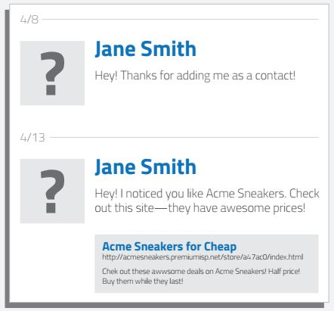
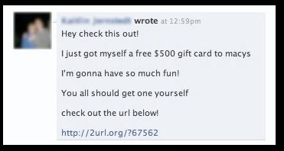
Examples of Phishing Attacks
Social Engineering
1
The example on the left is a targeted social engineering attack. Cybercriminals scan your profile for your likes and then send you a crafted message over social media trying to trick you into clicking the link, which would then steal your social media login and take over your profile sending out more phishing attacks to your friends/contact list.
The one on the right is an example of a mass phishing attack through social media. No doubt many of you have seen these in Facebook, from random people in messages, or from your friends through their timelines. Upon clicking the link, it would prompt you to log in again, but this time to a fake Facebook page, and steal your log in information and take over your profile sending out the same or another mass phishing attack to your friends and contacts.

Slide 49
Examples of Phishing Attacks
Social Engineering
1
The example on the left is a targeted social engineering attack. Cybercriminals scan your profile for your likes and then send you a crafted message over social media trying to trick you into clicking the link, which would then steal your social media login and take over your profile sending out more phishing attacks to your friends/contact list.
The one on the right is an example of a mass phishing attack through social media. No doubt many of you have seen these in Facebook, from random people in messages, or from your friends through their timelines. Upon clicking the link, it would prompt you to log in again, but this time to a fake Facebook page, and steal your log in information and take over your profile sending out the same or another mass phishing attack to your friends and contacts.

Slide 50
Can you spot the tell-tale signs of a phishing email?

Slide 51
Can you spot the tell-tale signs of a phishing email?

Slide 52
Signs of a Phishing Phone Call:
You've been specially selected (for this offer).
You'll get a free bonus if you buy our product.
You've won one of five valuable prizes.
You've won big money in a foreign lottery.
This investment is low risk and provides a higher return than you can get anywhere else.
You have to make up your mind right away.
You trust me, right?
You don't need to check our company with anyone.
We'll just put the shipping and handling charges on your credit card.

Slide 53
Tips to protect yourself from Phishing phone calls.
Don’t buy from an unfamiliar company. Legitimate businesses understand that you want more information about their company and are happy to comply.
Always check out unfamiliar companies with your local consumer protection agency, Better Business Bureau, state attorney general, the National Fraud Information Center, or other watchdog groups.
Obtain a salesperson’s name, business identity, telephone number, street address, mailing address, and business license number before you transact business. Some con artists give out false names, telephone numbers, addresses, and business license numbers. Verify the accuracy of these items.
Don’t pay for a “free prize.” If a caller tells you the payment is for taxes, he or she is violating federal law.
Never send money or give out personal information such as credit card numbers and expiration dates, bank account numbers, dates of birth, or social security numbers to unfamiliar companies or unknown persons.
If you have been victimized once, be wary of persons who call offering to help you recover your losses for a fee paid in advance.

Slide 54
Email Do’s and Don’ts
Do:
Always verify the sender of a message.
Always hover over web page links (URLs) in email messages to see where they link to – beware URL shortening services (like bit.ly) that may obscure the final web site destination.
Be skeptical of messages with odd spelling/grammar, improper logos or that ask you to upgrade or verify your account.
Report suspicious emails to spamnotify@edinboro.edu.
Don’t:
Open an attachment from an unknown sender. Consider the source and whether or not the file was expected.
Click on a link from an unknown sender.
Email someone your username or password.

Slide 55
Social Engineering Motivation Techniques
Authority
  Local or social authority (IRS calls)
Scarcity and urgency
  The offer is valid today only
Likeness
  Love scam
Fear
https://www.youtube.com/watch?v=nTorFTRcYDQ

Slide 56
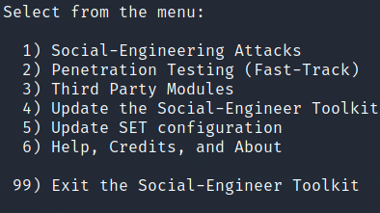
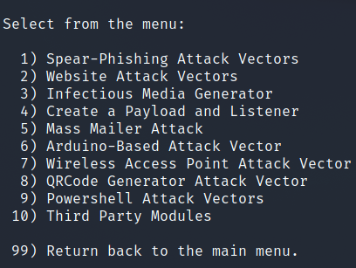
Social Engineering Tool
The Social-Engineer Toolkit (SET)

Slide 57
Credential Breaches

Slide 58
The Problem...(Web Applications)
Users choose bad passwords
Web sites on the Internet allow this to occur
Web sites get hacked – Users' passwords are cracked
Developers are not aware of proper methods of storing password hashes
The Internet stays “unsafe” and no progress is made in the web application world to educate or protect our users.
Applications continue to allow users to choose crappy passwords.
Applications continue to not allow security conscious users to protect themselves (See: List of websites that don't allow special characters in their passwords, or limit the length allowed)

Slide 59
Example Hashes / Hash Types
Type
Hash
Plaintext MD2 MD4 MD5 SHA-1 LM
NT MySQL323 MySQLSHA1
Cisco PIX
VNC Hash
badpass 9C5B091C305744F046E551DB45E7C036
640061BD33AA12D92FC40EA87EA408DE F1BFC72887902986B95F3DFDF1B81A5B AF73C586F66FDC99ABF1EADB2B71C5E46C80C24A 4CF3B1913C3FF376
986CA892BEAB33D1FC2E60C22EC133B7
0AFDA7C85EE805C2
229749C080B28D3AEFAB78279C4668E6E12F20FA
RtJk8qcKDPR.2D/E DAD3B1EB680AD902

Slide 60








Some Breached Companies

Slide 61

Data-Driven Statistical Attacks
(2009) 32 million passwords:
(2016) 117 million passwords:
(2017) 3 billion passwords:
Total: >10 billion passwords stolen from
>500 services

Slide 62
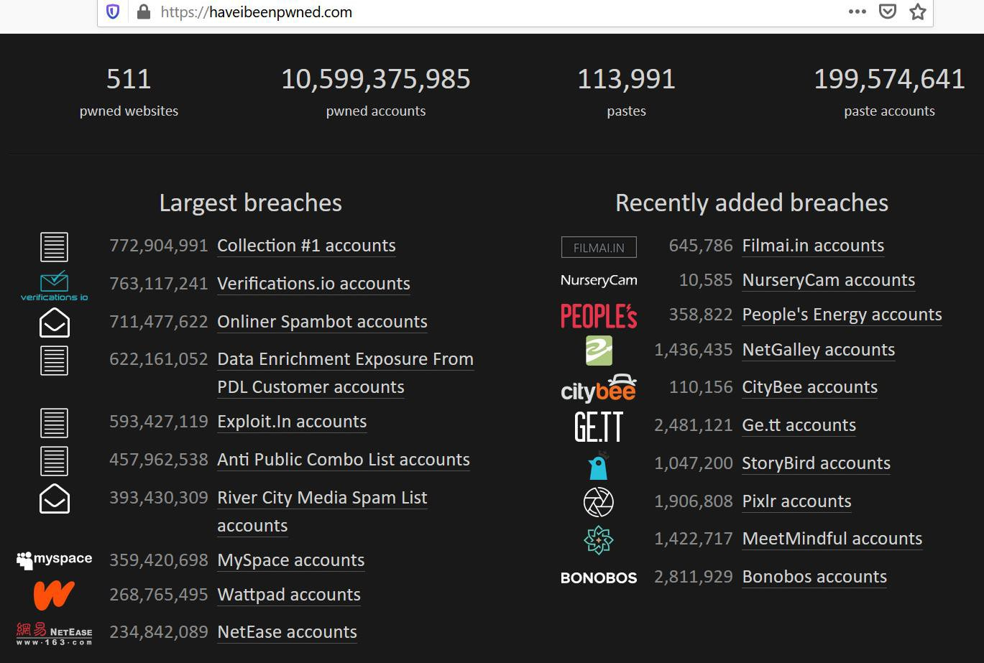
Have I Been Pwned (HIBP)

Slide 63
Summary
Website attacks are powerful since they have the potential to steal user credentials to compromise the user machine.
Detecting that a change has occurred on a website can be difficult.
The inherently unsecure model used for web interactions has a number of weak points.
Thus, everyone needs to know range of potential threats, including those against distant web sites.

Slide 64
Questions?

